Slide 1

Tabular Editor Scripting Magic
Output(Selected.Patronum);

Slide 2
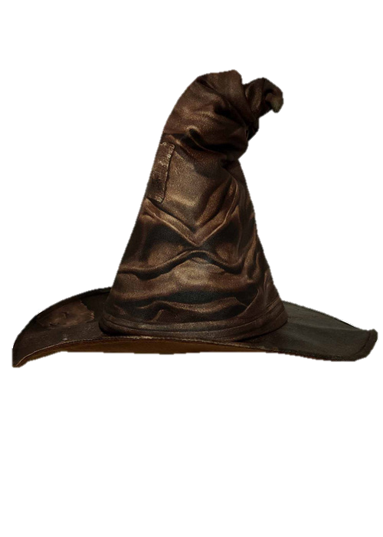

About me
Daniel Otykier
Inventor of Tabular Editor
CTO @ Tabular Editor ApS
Microsoft Data Platform MVP (6 years)
Power BI Contributor (“External Tools” ribbon)

Slide 3
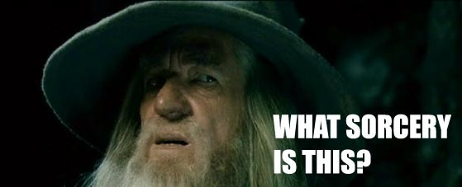
What is Tabular Editor scripting?
One size rarely fits all…
Pro software must be extensible
Tabular Editor uses C# for scripting
Available in both TE2 and TE3!
Use scripts to modify the model
Use scripts to interact with the user
Save scripts as custom macros
integrates directly in Tabular Editors UI
Don’t be afraid of C#
Many samples available online
ChatGPT / LLMs are really good at generating C# scripts!
https://tabulareditor.com/blog/using-llms-to-create-c-scripts-for-tabular-editor

Slide 4

Basic C# script examples
Split CamelCase
Create relationships
Create measures from columns
Create parameter table (“measure selector”)
Executing DAX queries in scripts
All these examples (and many more) are available on: https://docs.tabulareditor.com/te2/Useful-script-snippets.html
Notes:
01 Split CamelCase: tables just imported from source – use script to “prettify” names of both the tables and the columns within
02 Create relationships: after “prettifying” 03 Create measures from columns: Search for “amount” then run script on just those columns

Slide 5

Time Intelligence on Steroids

Slide 6
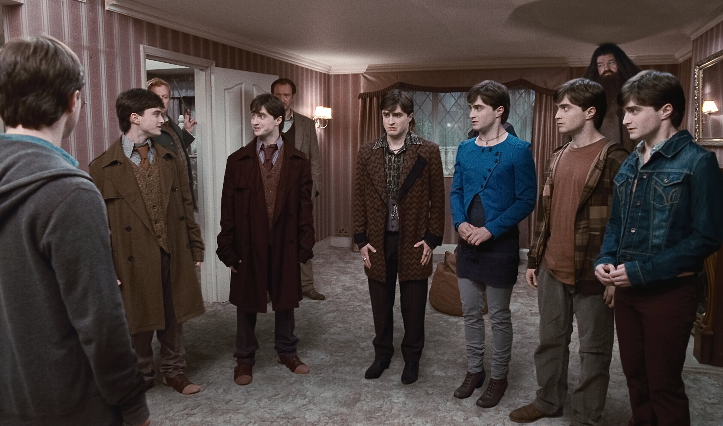
Master Model Pattern
Notes:
Load TMSL model in TE2 and explain the $ perspectives – show script and run it once
Close TE2 without saving
Show SSMS – no databases other than “AdventureWorks”
Run: deploy-submodels.cmd
Run: full-refresh-all.cmd
Show SSMS – now we have databases
Open TMSL in TE2 – modify date table, e.g.: add measure “Number of weekdays” – include in all perspectives: CALCULATE( COUNTROWS('Date'), 'Date'[Day Number Of Week] >= 2 && 'Date'[Day Number Of Week] <= 6 )
Save TMSL
Run: deploy-submodels.cmd again
Now, show that [Number of weekdays] is included in all models

Slide 7

Model Refresher
Credit:
Michael Kovalsky
https://elegantbi.com

Slide 8
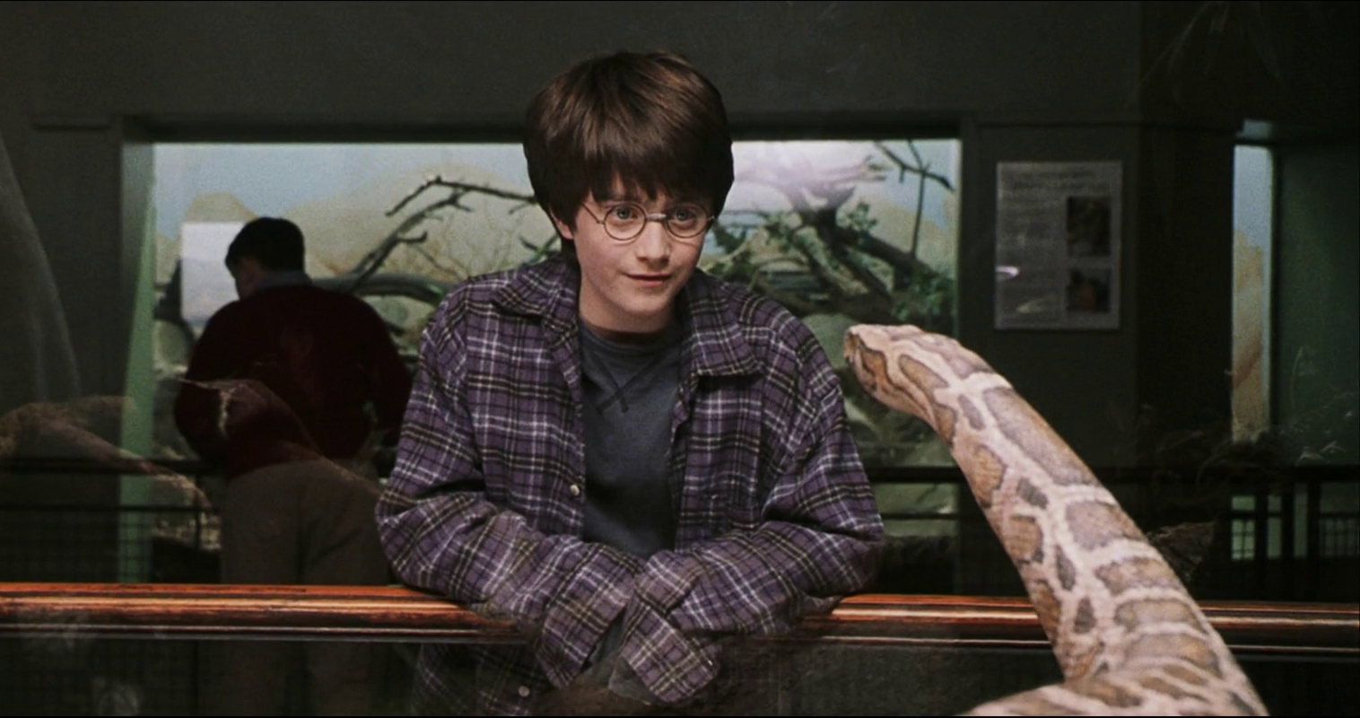
Invoking ChatGPT
Credit:
David Bojsen
https://tabulareditor.com/blog/translate-your-measures-using-tabular-editor-and-gpt3

Slide 9
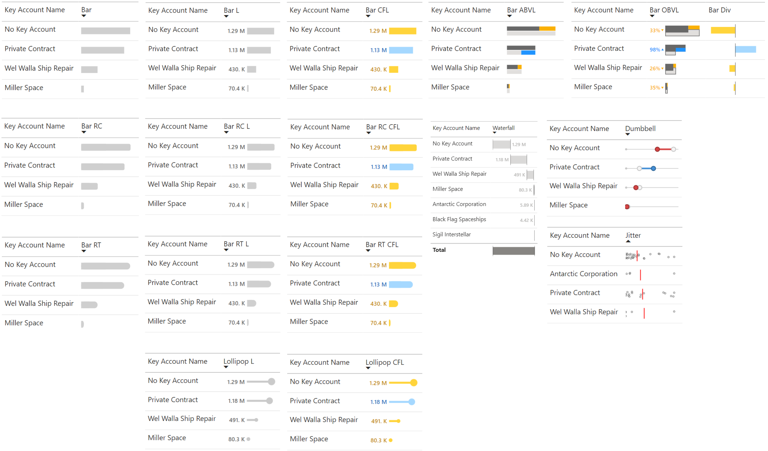

SVG Measures
Credit:
Kurt Buhler
https://data-goblins.com
Original SVGs:
https://kerrykolosko.com/portfolio/
https://tabulareditor.com/blog/using-tabular-editor-c-scripts-to-add-custom-visuals-to-power-bi-reports
Notes:
DO NOT use the local adventureworks model – because of locale settings, float values are not properly assigned to SVG strings… Use SpaceParts.pbix instead: Macros > Add SVG Chart > Bullet Chart > Label and Qualitative ranges 1. [Gross Sales] 2. [Total Budget] 3. Customer[Key Account Name]

Slide 10
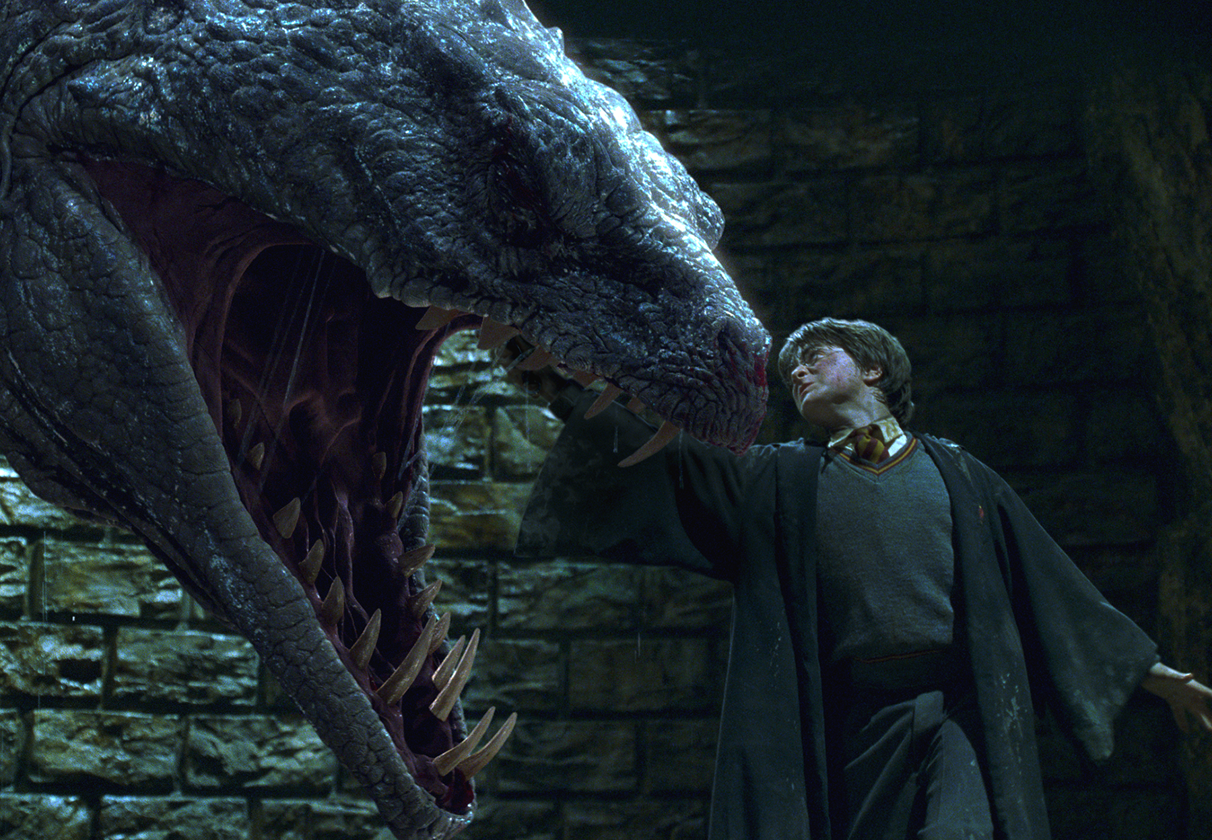
Snek!
Credit:
Kurt Buhler
https://data-goblins.com

Slide 11
Thank you
All demos in this deck can be found here:
https://github.com/otykier/training
C# script library
https://docs.tabulareditor.com/te2/Useful-script-snippets.html
https://docs.tabulareditor.com/common/CSharpScripts/csharp-script-library.html
LLMs and C# scripts
https://tabulareditor.com/blog/using-llms-to-create-c-scripts-for-tabular-editor
Happy scripting ☺

